Slide 1
Project Presentation Draft
By Christopher Faris
For CEN 4930C

Slide 2
Greeting
Hello classmates and Professor, my name is Christopher Faris and I am currently in my final year of the BAS-CTSD program at Valencia College. My project for the Seminar in Advanced Software Development is collecting and analyzing stock data via API, in the cloud with Python.

Slide 3
About my project
The concept of my project is to collect the closing prices of a couple stocks at the end of every day by calling a stock API with a Python script and log these values in a file, once enough data is collected I will take the raw data file and visualize it with tools like charts, graphs, etc. As of writing this I plan to collect data for 60 days (around 2 months). The entire data collection process will be automated by hosting my Python script on a cloud website. The next few slides will show a peek at my task running on the cloud as well as how the values are logged in the data file.

Slide 4



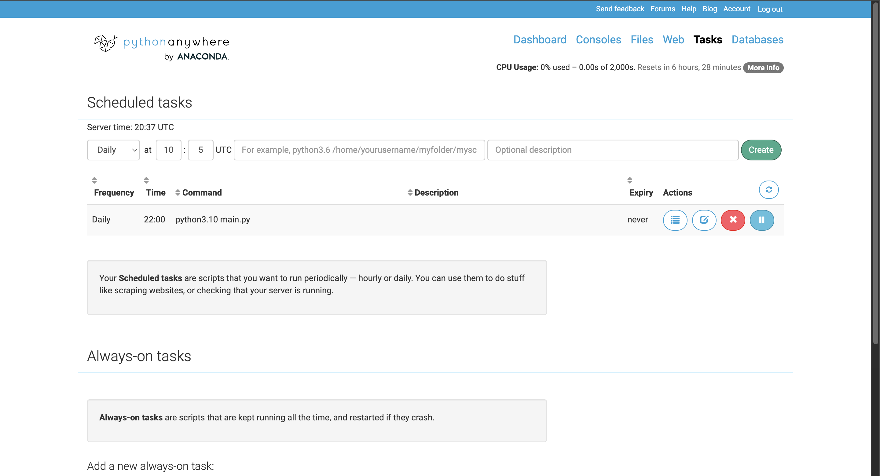
Task in the cloud
z
Using Python Anywhere I uploaded my Python script and the text file where the data is sent, specified a Python version to use and a frequency and time for running the task and I am all set up. My task runs at 22:00 UTC everyday, or 6PM EST. I can also view a log that shows the output and result code every time the task is executed.

Slide 5
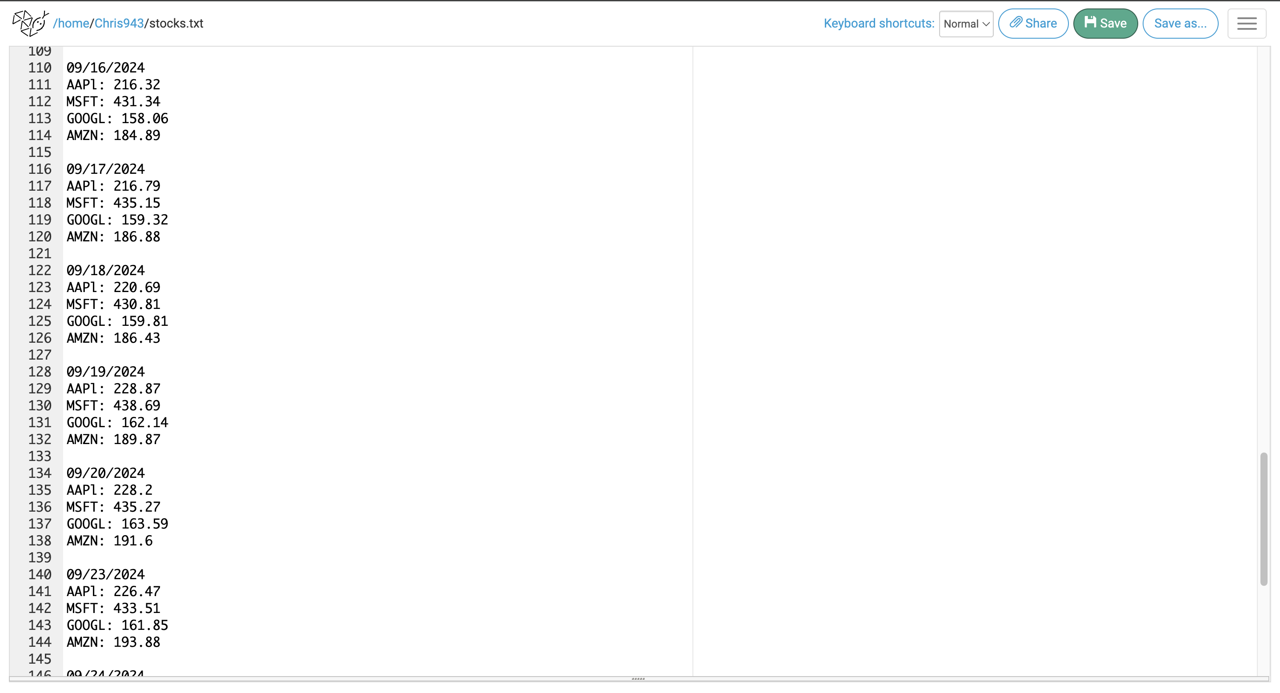
Data collection format
z
Here is a look at a couple days of data I have collected so far, each time the task executes it stores the date, as well as the closing price for each of the 4 tickers in a text file. It is worth noting the script only logs values on weekdays since the market is closed on weekends, therefore some dates are skipped over.

Slide 6
Languages/tools used
My programming language of choice for this project was Python, the superior option for scripting and automated tasks, data collection and data visualization too if that is apart of your project. Some notable Python libraries I used include Matplotlib and Pandas for data visualization and requests for working with an API. I used the website “PythonAnywhere” for hosting my script, an easy to work with platform for hosting tasks and web apps in the cloud. The API I used to gather stock price data is AlphaVantage.

Slide 7
Implementation
In the beginning, I did not have a set time frame in mind for collecting data, after a couple weeks I decided on a roughly 60-day period. Another change in implementation I had was the tool chosen for data visualization, initially wanting to use something like Tableau, but ultimately deciding on the Matplotlib Python library. I made this change because of the vast range of customization options offered, as well as the opportunity to learn a new skill in Python made it more enticing. Other than these 2 points no other changes were made.

Slide 8
Findings and results
While I still have about 1 more week of data collection left, I have been comparing last year’s data to this year’s along the way. So far, I have noticed an increase in prices across the board this year compared to last year, these increases range from about $20-$50 depending on the ticker and date. Once I am done collecting data for this year I will do a final analysis and comparison with my complete data and last year’s.

Slide 9
Technical challenges
The main roadblock I had was in the beginning stages of the project trying to setup my script on PythonAnywhere. When the script would run on the website it would throw an error for unsuccessfully making an API request. After doing some research, I learned that free account users could not make requests to just any source of their choosing. To fix this I just had to sign up for a premium account for $5/month, since premium accounts are not restricted to only being able to use websites and API’s on the whitelist. Another minor challenge I had was getting the data to properly format in the file it was saved to, after some tweaking and testing this was quickly ironed out.

Slide 10
Successes and disappointments
Successes-
Data collection script functions as envisioned.
Formatted data that is easily readable and sortable.
Graphs and charts produced in a manner I had envisioned.
Disappointments-
Wish I had more time so I could collect more data for more extensive analysis.

Slide 11
Project do-over
For this project I do not believe I would change anything major, for all the tools I chose to use and decisions I made worked out in that my project went in the direction I had hoped it would. Everything has executed very well.

Slide 12
Thank you for your time
I sincerely appreciate your time today with me as I presented my project. I hope you not only enjoyed my presentation of my findings and results but maybe learned something new as well. I look forward to seeing what my peers have accomplished this semester. Have a great day!

